Slide 1

Algorithms and Data Structures 1 CS 0445
Fall 2023
Java Review – Part 1
Sherif Khattab
ksm73@pitt.edu
(Slides are adapted from Dr. Ramirez’s and Dr. Farnan’s CS1501 slides.)

Slide 2
Announcements
Lab 0 is due this Friday (not graded)
Recitations start next week
Homework 1 is due next Tuesday
Please find on Canvas
VS Code setup instructions
Code handouts repository
Debugging in VS Code video
JDB Example

Slide 3
Today’s Agenda
Java Review – Part 1
Reference types and variables
Class design
Composition
Inheritance
toString() and equals()

Slide 4
Reference Types and Variables
Java has
primitive types: e.g., int, double, char, byte, etc.
reference types: all other types, e.g., String, Integer, Character, Byte, etc.
An object is an instance of a class
A reference variable points to an object
For example, String x = new String();
An object of class String created using new
x: reference variable pointing to the created String object
The String object that x points to is a referenced object

Slide 5
Composition
A class uses composition when it has a data field that is an instance of another class
Composition is a “has a” relationship
Check the Square class in ClassCompositionExample/Square.java
Each Square object has a sideLength, area, and perimeter
Thus, each object of type Square contains three reference variables pointing to three objects of type Integer

Slide 6
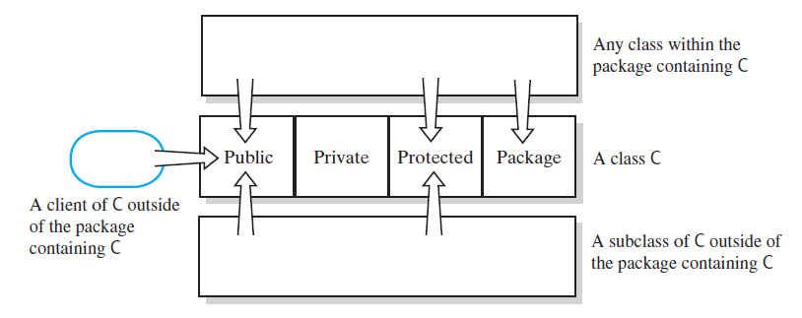
Access Modifiers
Public, private, protected, and package access of the data fields and methods of class C

Slide 7
Inheritance
A class may inherit from another class
Inheritance is a “is a” relationship
Check the ColoredSquare class in InheritanceExample/ColoredSquare.java
Each ColoredSquare object inherits all data fields and methods from Square
Thus, each object of type ColoredSquare is also an object of type Square
The opposite is not true!
ColoredSquare is a sub-, child, or derived class
Square is a super- or parent class

Slide 8
Class Constructors
Constructors typically initialize an object’s data fields
Default constructor has no parameters
A class may have one or more parametrized constructors
Constructors are called using the new keyword

Slide 9
Invoking Constructors from Within Constructors
Can explicitly call a constructor from another constructor
Use this(…)
Constructor of subclass automatically calls default constructor of superclass
Can explicitly call a different constructor of superclass from constructor of subclass
Use super(…)
Can use this to invoke constructor of superclass
The subclass must not have a constructor with the same parameter list; otherwise, the subclass constructor will be called

Slide 10
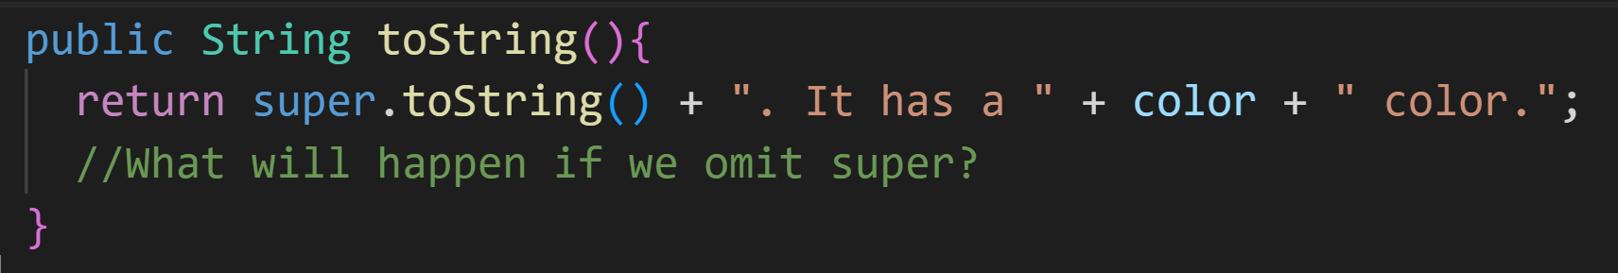
Overriding Superclass Methods
Method Overriding
When a subclass defines a method with
the same name
the same number and types of parameters
and the same return type
as a method in the superclass
You can use super. to bypass overriding
i.e., to call an overridden method of the superclass
e.g., overriding method invokes the overridden method

Slide 11
Overriding and Overloading Methods
But … repeated use of super is not allowed

Slide 12
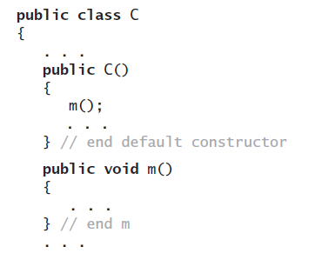

Overriding and Overloading Methods
To specify that a method definition cannot be overridden with a new definition in a subclass
Make it a final method by adding the final modifier to the method header.

Slide 13
The Class Object
Java has a class—named Object
It is at the beginning of every chain of subclasses
An ancestor of every other class
Class Object contains certain methods
Examples: toString, equals, clone
However, in most cases, you must override these methods

Slide 14
toString()
Need to override the definition of toString
Cause it to produce an appropriate string for data in the class being defined

Slide 15
equals
Object’s equals method compares the addresses of two objects
Overridden method, when added to the class Square, detects whether two Square objects are equal by comparing their data fields.
Check equals() method inside Square and ColoredSquare

Slide 16
Overloading Methods
When subclass has a method with same name as a method in its superclass,
but the methods’ parameters differ in number or data type …
Method in subclass overloads method of superclass.
Java is able to distinguish between these methods
Signatures of the methods are different
It is recommended to use the @Override tag to inform the compiler of your intention to override a method
Avoiding a common mistake in which overriding is intended but overloading happens instead

Slide 17
Some rules regarding Inheritance
Every class is a subtype (and supertype) of itself
Right-hand-side type of an assignment statement must be subtype of the left-hand-side
Assume the following declarations: X x; Y y;
x = y; is only correct when Y is a subtype of X
Actual parameter must be subtype of formal parameter
Assume the following declaration and method definition:
Y y;
void func(X x){ …}
A method call func(y) is correct only when Y is a subtype of X
In both cases, if y’s type is unknown because of using a wildcard (covered next lecture), X must be Object

